Slide 1
Applies Data Structure and Application
Dr Sachin K Saxena Sr Data Analyst, Portugal, MNC
Ex-Sr Software Engineer - Data Scientist

Slide 3
Content
Array: Representation of Single and Multidimensional Arrays
Address Calculation
Operations on Arrays
Application of Arrays: Matrix Multiplication
Application of Arrays: Character String Operation

Slide 4
Array
Array is a collection of similar data types grouped under one name
Its also called vector value
We can Access or differentiate all the elements in an array using index values
This concepts is supported by many programming languages

Slide 5
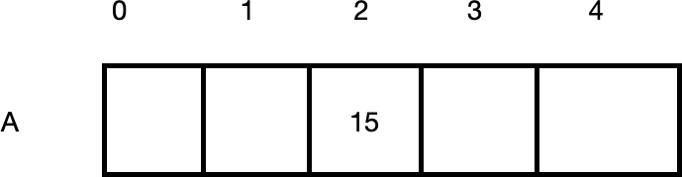
Array
Example :
Int A [ 5 ];
// Initialise or declaration
A[ 2 ] = 15;
// Access

Slide 6
Array
To access all elements in an array , we can traverse through it for example
int A[ 5 ] = {2,4,6,8};
for (i = 0; i < 5 ; i++)
{
printf( “%d”, A[ i ] );
}

Slide 7
Array
The elements inside the array can be access through the subset or through the pointer
int A[ 5 ] = {2,4,6,8};
for (i = 0; i < 5 ; i++)
{
printf( “%d”, A[ i ] );
printf( “%d”, A[ 2 ] );
printf( “%d”, 2[ A ] );
printf( “%d”, *(A + 2 ) );
}
// Example of accessing elements inside an array

Slide 8
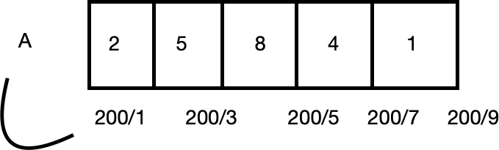
Array in Compilers
Any location in an array can be accessed with the help of base address
Example :
int A[ 5 ] = { 3,5,8,4,2 }
The formula used by any compiler to convert it is
Addr( A[ i ] ) = Lo + i * w
Where ;
Lo is i
w
base address
Index
Size of Data Type
0
1 2
3
4

Slide 9
Array in Compilers
Base address of an array will be updated when the program starts running and once the memory is allocated
So the address of this is known during run time
As the base address is relative the formula for it is also relative formula
Suppose a in a different language if the index value starts from 1 then the formula for the compiler is as follows
Addr( A[ i ] ) = Lo + ( i -1 )* w

Slide 10
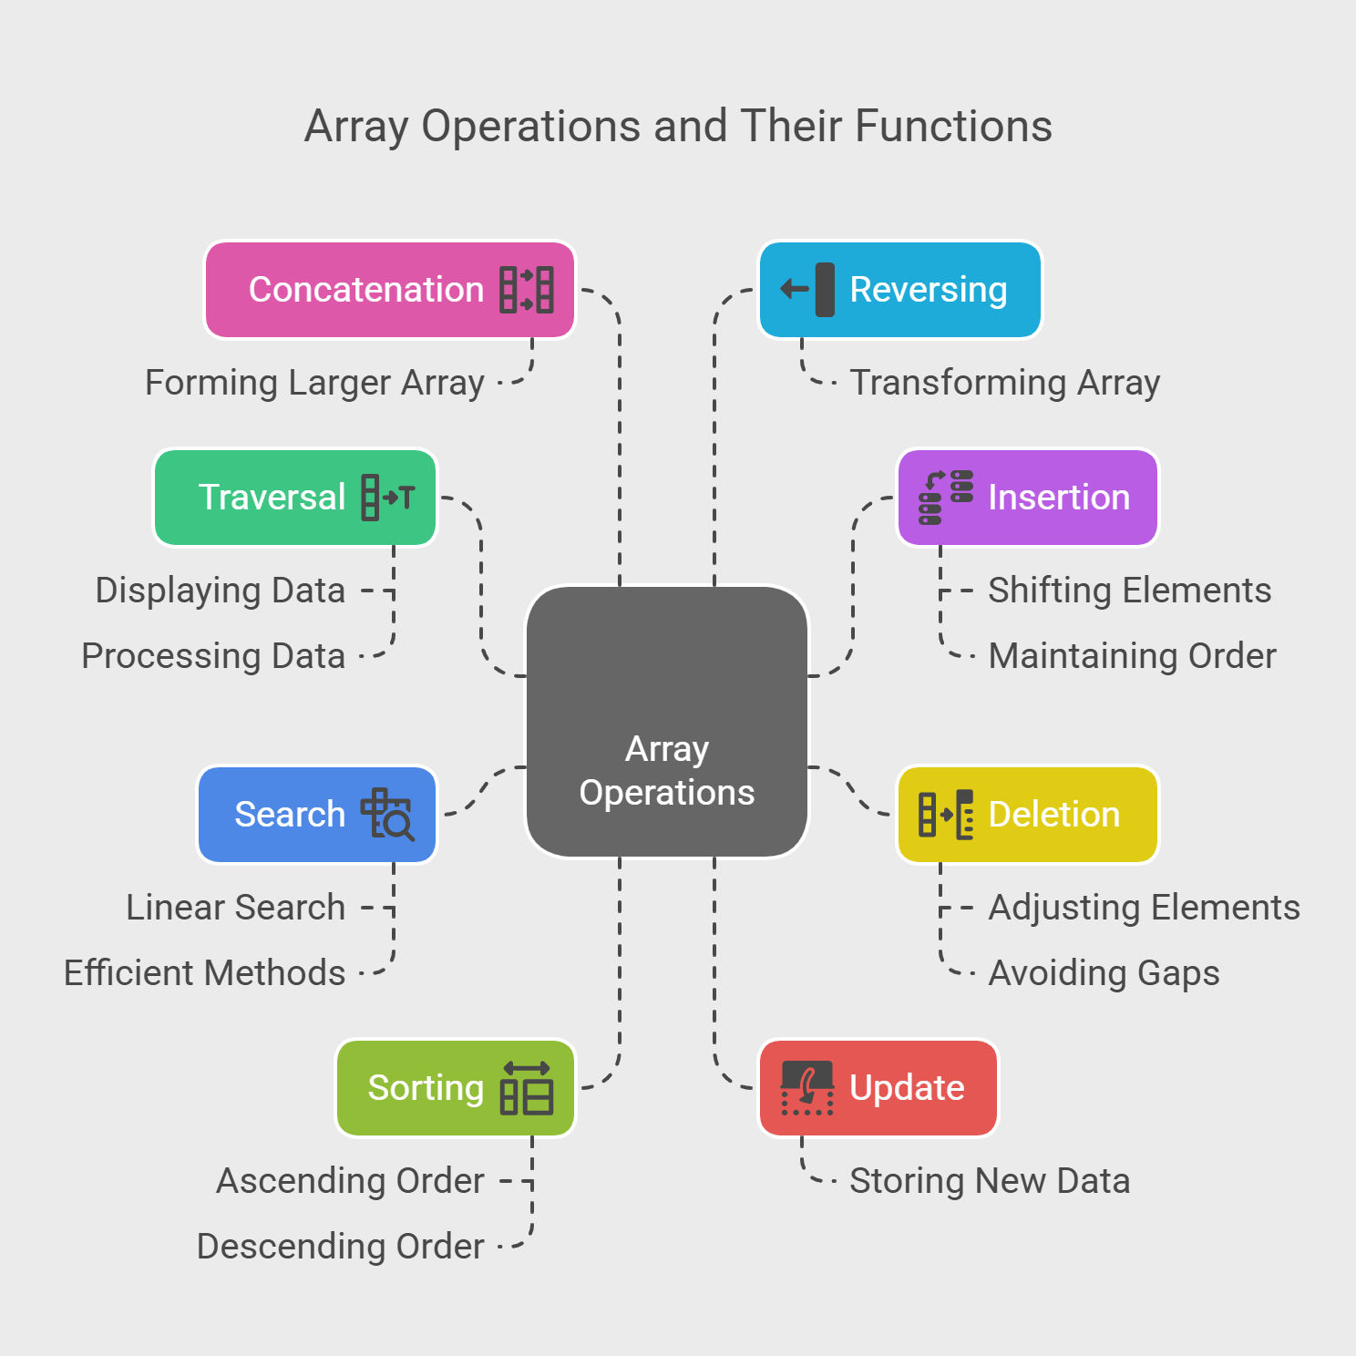
Operations on Arrays

Slide 11
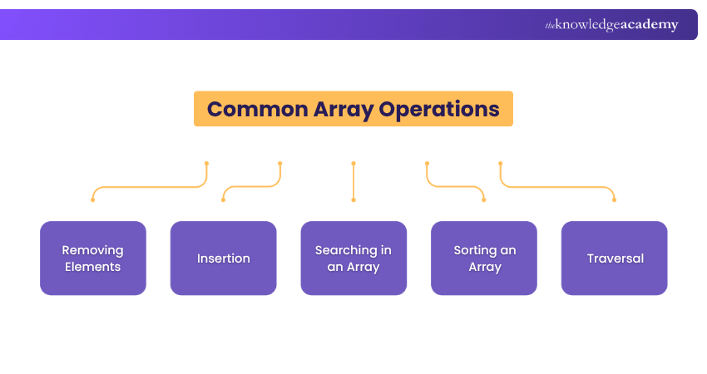
Operations on Arrays

Slide 12
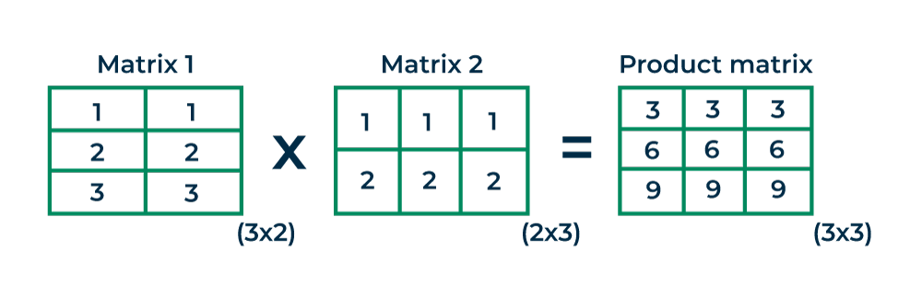
Application of Arrays: Matrix Multiplication

Slide 13
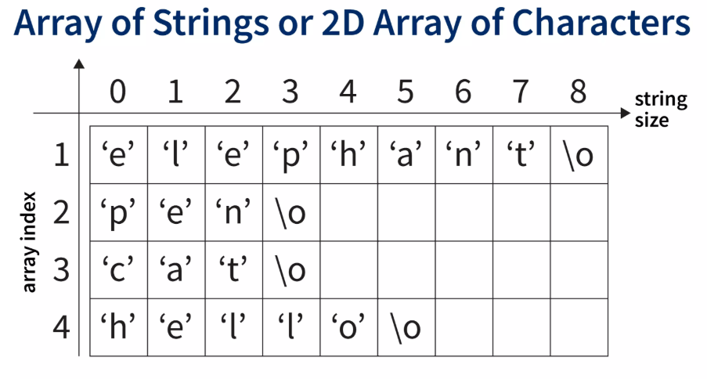
Application of Arrays: Character String Operation

Slide 14
Application of Arrays: Character String Operation
#include <stdio.h>
#include <string.h>
int main()
{
char car[5][20] = {"Mahindra", "Audi", "Lambhorgini", "Hyundai", "Tata Motors"};
for(int itemNumber = 0 ; itemNumber < 5 ; itemNumber++)
{ //Iterate over selected string
for(int characterPosition = 0 ; characterPosition < strlen(car[itemNumber]) ; characterPosition++)
printf("%c", car[itemNumber][characterPosition]);
printf("\n");
}
return 0;
}

Slide 15
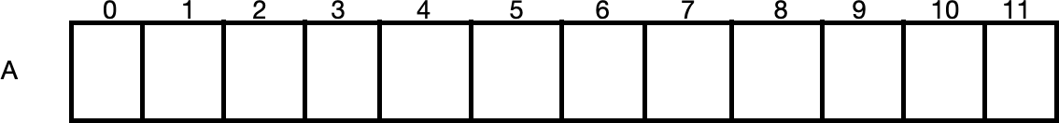
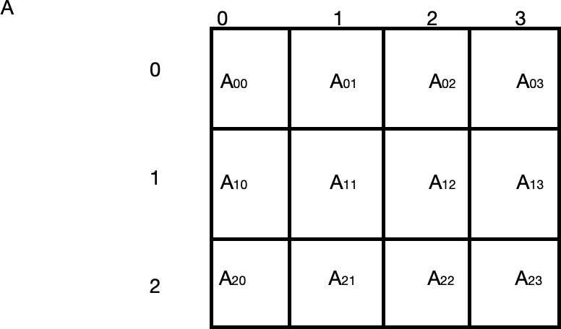
Row Major Order
Row major mapping
Here the elements are stored row by row
Example :
A00
A01
A02
A03
A10
A11
A12
A13
A20
A21
A22
A23
The formula for accessing this 2D array is
Add( A[ i ] [ j ]) = L0 + [ i * n + j ] * w

Slide 16
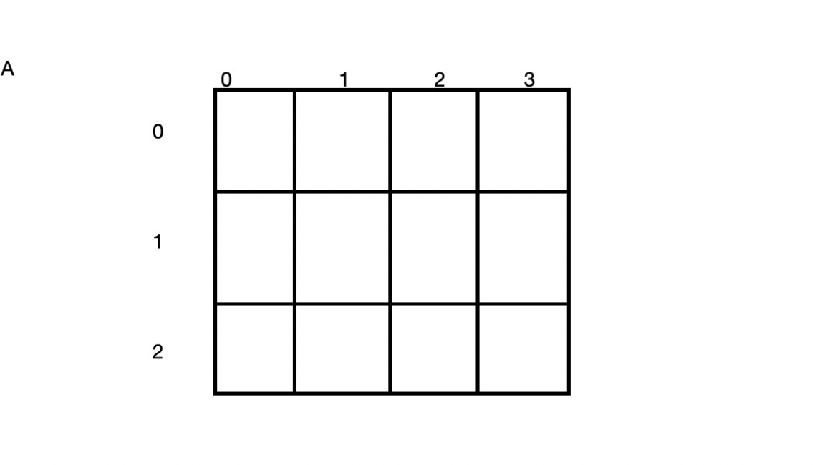
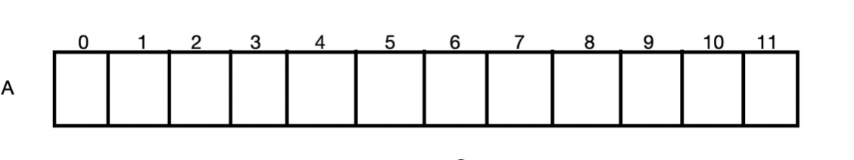
Column Major Order
Here the elements of array are stored in column by column
A00
A01
A02
A03
The formula for obtaining address for each element is
Add ( A[ i ][ j ] ) = L0 + [ i * m + j ] * w
A10
A11
A12
A13
A20
A21
A22
A23
A00
A10
A20 A01
A11
A21 A02
A12
A22
A03 A13
A23

Slide 17
Question based on RMO and CMO

Slide 18
Static vs Dynamic Arrays
Static array means the size of an array is static I.e.; fixed
Dynamic array means the size of an array is Dynamic I.e.; flexible
When an array is created it is created inside Stacking the memory
The size of the array is decided during at compile time
When declaring an array it must be a static value only and not variable type in c language however in c++ dynamic allocation is possible during compile time
We can create array inside Heap: When accessing any value inside a heap it must be done through a pointer
Example :
Void main( )
{
int A[5]; int *p;
C++ p = new int[5];
C lang p =( int * ) malloc ( 5* sizeof ( int ) );
.
.
.

Slide 19
Program 1: Static vs Dynamic Arrays
#include <stdio.h> #include <stdlib.h>
int main()
{
int A[5]={2,4,6,8,10};
int *p; int i;
p=(int *)malloc(5*sizeof(int)); p[0]=3;
p[1]=5;
p[2]=7;
p[3]=9;
p[4]=11;
for(i=0;i<5;i++) printf("%d ",A[i]);
printf("\n"); for(i=0;i<5;i++)
printf("%d ",p[i]);
return 0;
}

Slide 20
Program 2: 2D Array
#include <stdio.h> #include <stdlib.h>
int main()
{
int A[3][4]={{1,2,3,4},{2,4,6,8},{1,3,5,7}};
int *B[3]; int **C; int i,j;
B[0]=(int *)malloc(4*sizeof(int)); B[1]=(int *)malloc(4*sizeof(int)); B[2]=(int *)malloc(4*sizeof(int));
C=(int **)malloc(3*sizeof(int *)); C[0]=(int *)malloc(4*sizeof(int)); C[1]=(int *)malloc(4*sizeof(int)); C[2]=(int *)malloc(4*sizeof(int));
for(i=0;i<3;i++)
{
for(j=0;j<4;j++) printf("%d ",C[i][j]);
printf("\n");
}
return 0;
}

Slide 21
Program 3: 2D Array
#include<stdio.h>
int main()
{
int A[3][3],i,j;
printf("Size of integer variable : %d Bytes",sizeof(int));
printf("\nEnter array elements : \n");
for(i=0;i<3;i++)
for(j=0;j<3;j++)
scanf("%d",&A[i][j]);
printf("\nRow Col - Address - Values ");
for(i=0;i<3;i++)
for(j=0;j<3;j++)
printf("\n %d %d - %u - %d",i,j,&A[i][j],A[i][j]);
}

Slide 22
Question: 1
Maximum Subarray Sum
Implement a function that takes an input a vector of integers, and prints the maximum subarray sum that can be formed. A subarray is defined as consecutive segment of the array. If all numbers are negative, then return 0.
Input
{-1,2,3,4,-2,6,-8,3}
Output
13

Slide 23
Solution: 1
#include<vector>
using namespace std;
int maxSubarraySum(vector<int> arr){
// Complete this function, your function should return the maximum subarray sum
int n = arr.size();
int current_sum = 0; // stores sum of current subarray
int max_sum = 0; // stores maximum sum found so far
for(int i = 0; i < n; i++){
current_sum += arr[i]; // add current element
if(current_sum < 0){
current_sum = 0; // reset if sum becomes negative
}
if(current_sum > max_sum){
max_sum = current_sum; // update maximum
}
}
return max_sum;
}

Slide 24
Quiz: 1
Let A be a two- dimensional array declared as follows:
A : array [1……10] [1……15] of integer;
Assuming that each integer takes one memory location . The array is stored in row-major order and the first element of the array is stored at location 100 , what is the address of the element A[i][j] ?
15i+j+84
15i+j+86
10i+j+84
i+10j+84

Slide 25
Quiz: 1: Solution
Let A be a two- dimensional array declared as follows:
A : array [1……10] [1……15] of integer;
Assuming that each integer takes one memory location . The array is stored in row-major order and the first element of the array is stored at location 100 , what is the address of the element A[i][j] ?
Address(A[i][j])=Base Address+[(i−L1​)×N+(j−L2​)]×Size
Address(A[i][j])=100+[(i−1)×15+(j−1)]
15i+j+84
15i+j+86
10i+j+84
i+10j+84

Slide 26
Quiz: 2
What is the output of the following C code? Assume that the address of x is 2000 (in decimal) and an integer requires four bytes of memory.
int main( )
{ unsigned int x[4] [3] ={{1, 2, 3}, {4, 5, 6}, {7, 8, 9}, (10, 11, 12}};
printf("%u,%u, %u", x+3, *(x+3),*(x+2)+3);
}
2036, 2036, 2036
2036, 10, 10
2036, 4, 10
2036, 36, 20

Slide 27
Quiz: 2: Solution
What is the output of the following C code? Assume that the address of x is 2000 (in decimal) and an integer requires four bytes of memory.
int main( )
{ unsigned int x[4] [3] ={{1, 2, 3}, {4, 5, 6}, {7, 8, 9}, (10, 11, 12}};
printf("%u,%u, %u", x+3, *(x+3),*(x+2)+3);
}
Each row has 3 integers Each integer = 4 bytes
x + 3 = 2036, *(x+3) = address of x[3][0] = 2036, *(x+3) = address of x[3][0] = 2036, *(x+2)+3 = 2036
2036, 2036, 2036

Slide 28
Quiz: 3
If A and B are two Matrices, for multiplying A X B which if the following representations will be efficient:
A in row-Major and B in Column Major
B in row-Major and A in Column Major
Independent of presentation

Slide 29
Quiz: 3: Solution
If A and B are two Matrices, for multiplying A X B which if the following representations will be efficient:
A in row-Major and B in Column Major
B in row-Major and A in Column Major
Independent of presentation

Slide 30
Thanking you !!!!
Any question !!!!!
Download PPT : https://github.com/sachin365123/Applies-Data-Structure-and-Application-GLA-Online-Sessions-Jan---Jun-2026

